Slide 1
Micro services

Slide 2
What is Monolithic?
“Monolithic” means composed all in one piece. Monolithic software is designed to be self-contained; components of the program are interconnected and interdependent rather than loosely coupled as is the case with modular software programs. In a tightly-coupled architecture, each component and its associated components must be present in order for code to be executed or compiled.
What is Microservices?
Microservices - also known as the microservice architecture - is an architectural style that structures an application as a collection of services that are
Highly maintainable and testable
Loosely coupled
Independently deployable
Organized around business capabilities.
The microservice architecture enables the continuous delivery/deployment of large, complex applications. It also enables an organization to evolve its technology stack.

Slide 3
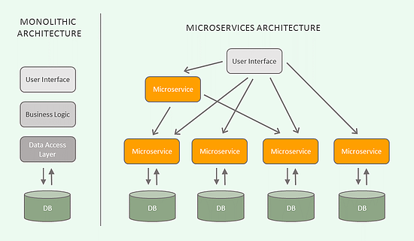
Monolithic Vs Microservice

Slide 4
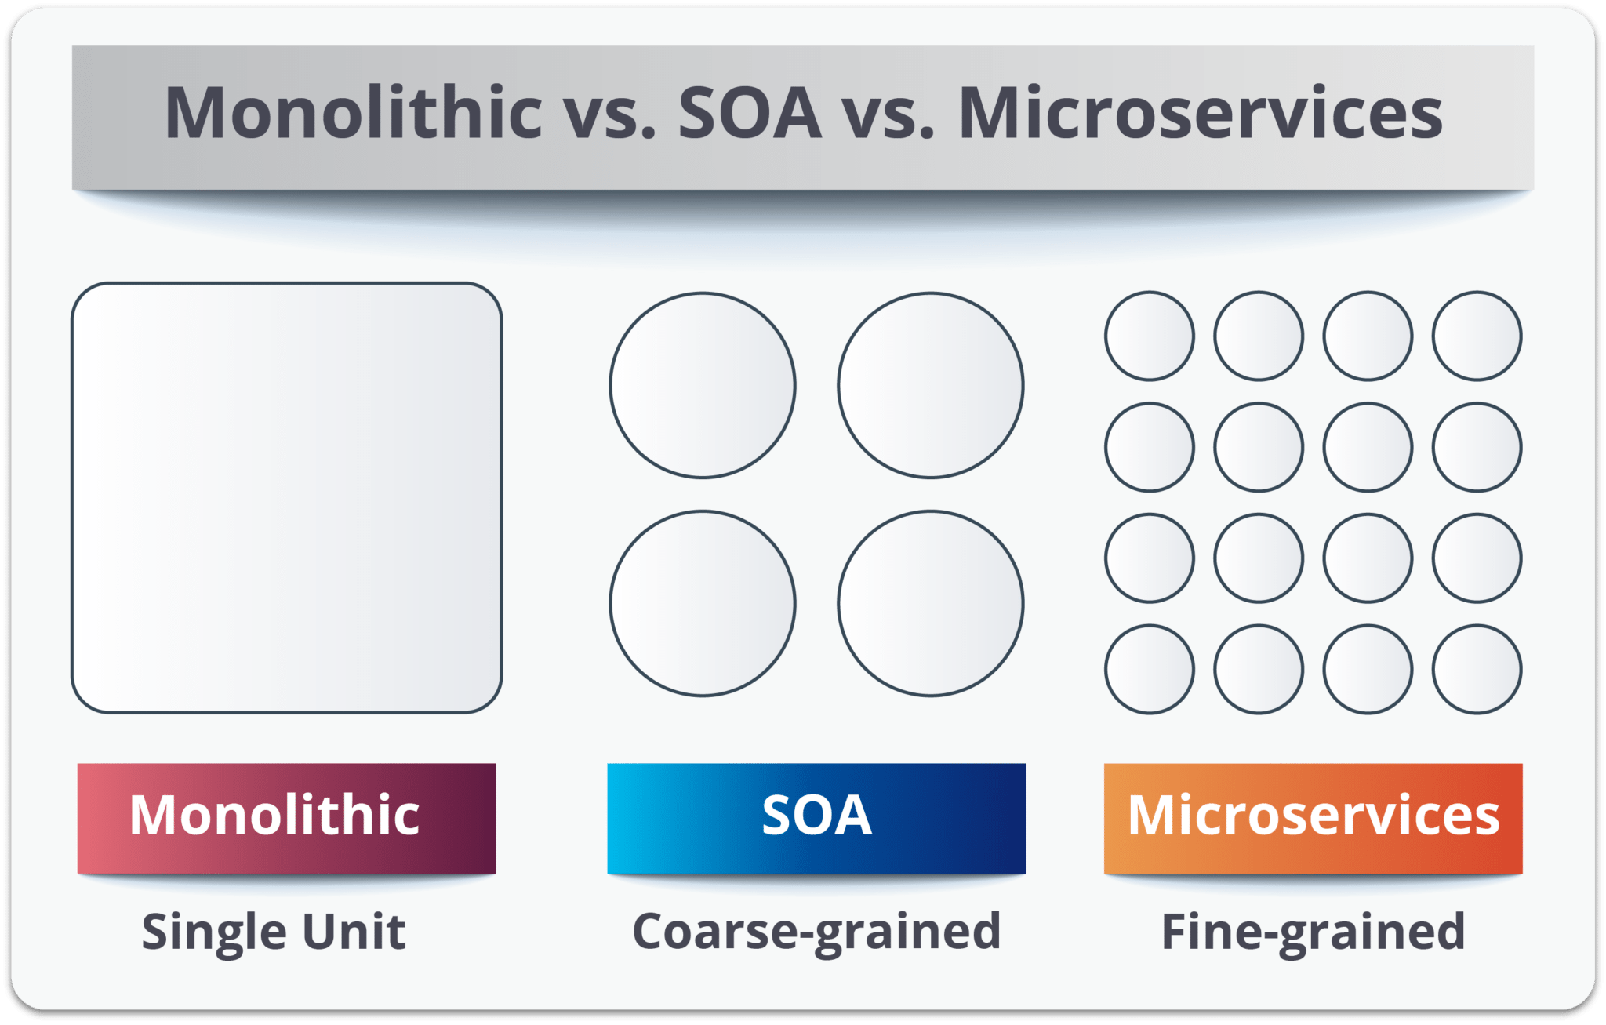

Slide 5
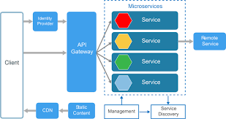
What is a Microservices Architecture?

Slide 6
Microservices Pros and Cons:
Pros
Microservice architecture gives developers the freedom to independently develop and deploy services
A microservice can be developed by a fairly small team
Code for different services can be written in different languages (though many practitioners discourage it)
Easy integration and automatic deployment (using open-source continuous integration tools such as Jenkins, Hudson, etc.)
Easy to understand and modify for developers, thus can help a new team member become productive quickly
The developers can make use of the latest technologies
The code is organized around business capabilities
Starts the web container more quickly, so the deployment is also faster
When change is required in a certain part of the application, only the related service can be modified and redeployed—no need to modify and redeploy the entire application

Slide 7
Better fault isolation: if one microservice fails, the other will continue to work (although one problematic area of a monolith application can jeopardize the entire system)
Cons:
Due to distributed deployment, testing can become complicated and tedious.
The architecture brings additional complexity as the developers have to mitigate fault tolerance, network latency, and deal with a variety of message formats as well as load balancing.
Being a distributed system, it can result in duplication of effort.
When number of services increases, integration and managing whole products can become complicated.

Slide 8
In addition to several complexities of monolithic architecture, the developers have to deal with the additional complexity of a distributed system
Developers have to put additional effort into implementing the mechanism of communication between the services
Handling use cases that span more than one service without using distributed transactions is not only tough but also requires communication and cooperation between different teams
The architecture usually results in increased memory consumption

Slide 9
Service Registry
Eureka
Service-1
DB
Service-2
DB
API Gateway(ZUUL)
Client
Service-3
DB
Service-4
DB

Slide 10
Why do we need API Gateway?
API Gateway, aka Edge Service, provides a unified interface for a set of microservices so that clients no need to know about all the details of microservices internals. However, there are some pros and cons of using API Gateway pattern in microservices architecture.
Pros:
Provides easier interface to clients
Can be used to prevent exposing the internal microservices structure to clients
Allows to refactor microservices without forcing the clients to refactor consuming logic
Can centralize cross-cutting concerns like security, monitoring, rate limiting etc.

Slide 11
Cons:
It could become a single point of failure if proper measures are not taken to make it highly available
Knowledge of various microservice API may creep into API Gateway

Slide 12
What is Eureka?
In simple word Eureka is a service Registry or we can say it is an embedded server provided by Netflix third party which integrate with spring framework.
Main purpose to use Eureka : Micro service Registration and Discovery with Spring Cloud and Netflix's Eureka
What is the use of Eureka?
http://localhost:8083/service3/payment
http://serviceName/service3/payment
Instead of using IP address and port no we can use service name

Slide 13
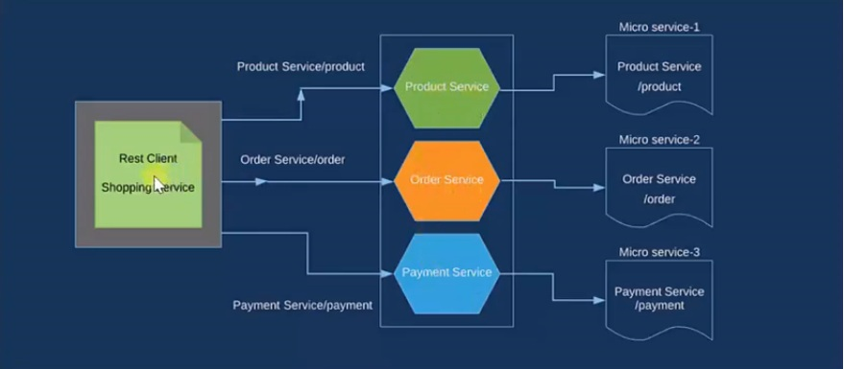
Eureka Architectural diagram:

Slide 14
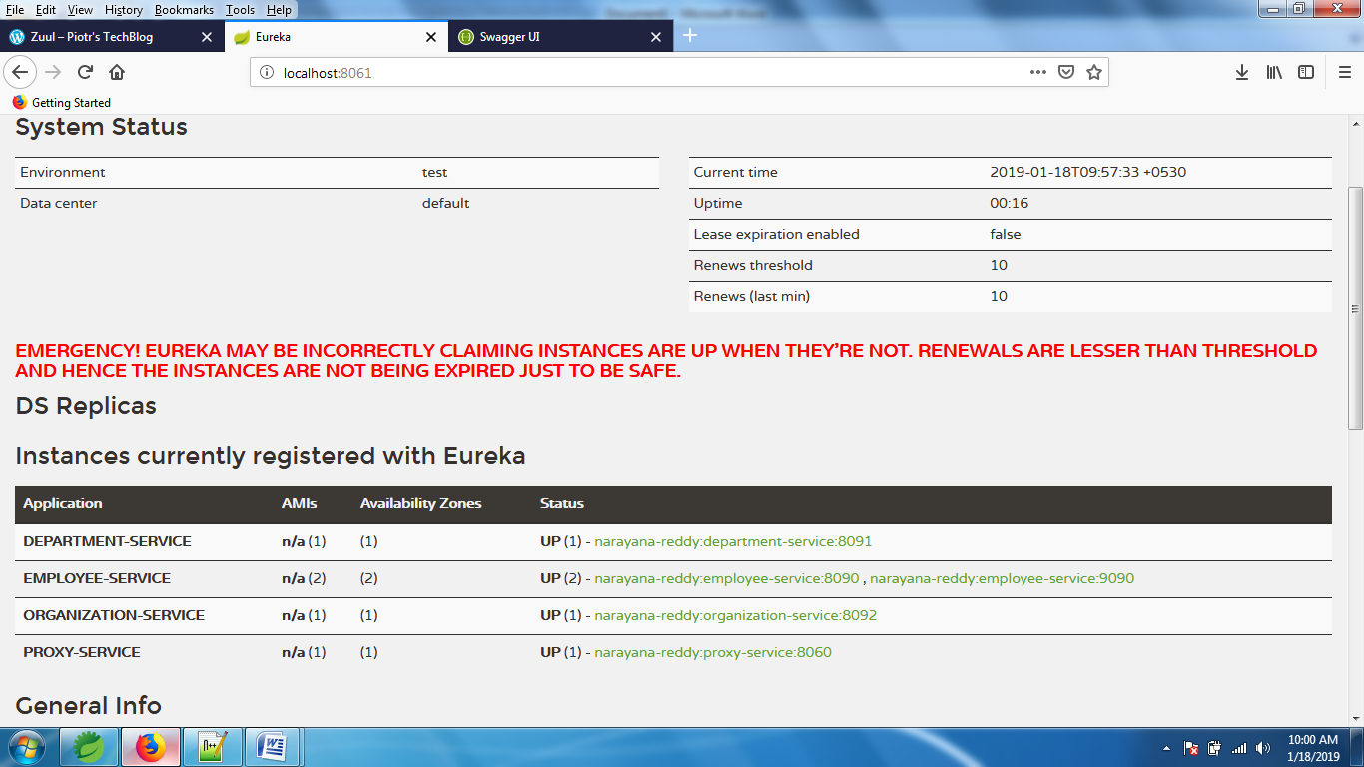

Slide 15
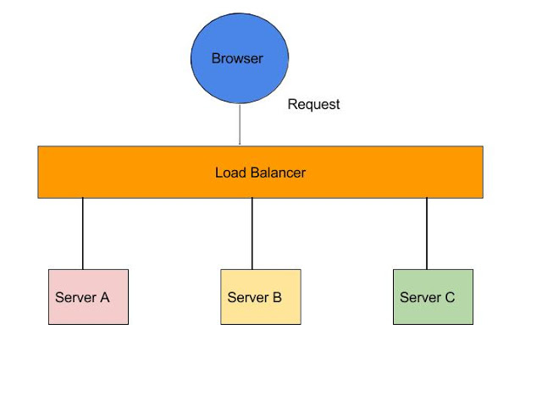
Ribbon

